Slide 1

Week 3 Project Updates
COMP 3601 - Libra

Slide 2
Project Management
Report Designations
Revised Gantt Chart

Slide 3
Report Designations
Initial Design Report
Sophie
Advertisement/ Magazine
Tingting
Operations Manual
Final Design Report
Harry
Kelvin

Slide 4
Revised Gantt Chart

Slide 5
Software Design
User Stories
Draft UI designs
Software Development Progress

Slide 6
User Stories
UC 4.1 - Export to Music File
As a user, I want to be able to save my recorded music to a file so that I can play it on other devices
Acceptance Criteria:
Clicking the "Save/Export" button on the User Interface will result in a pop-up window allowing the user to browse to a location to save the file.
The music file will be output and saved in the specified location with the specified name.
The music file will contain all notes and durations that had been recorded using the application, including the tempo.
The music file will be in the format specified in the music file description notes with no errors
User stories have been developed for the software to help determine requirements for usability and feasibility of our implementation.
Example user story on the right details the format.
All user stories have a user perspective written requirement.
Acceptance criteria are listed below the description and specify the circumstances under which the user story is considered complete.

Slide 7
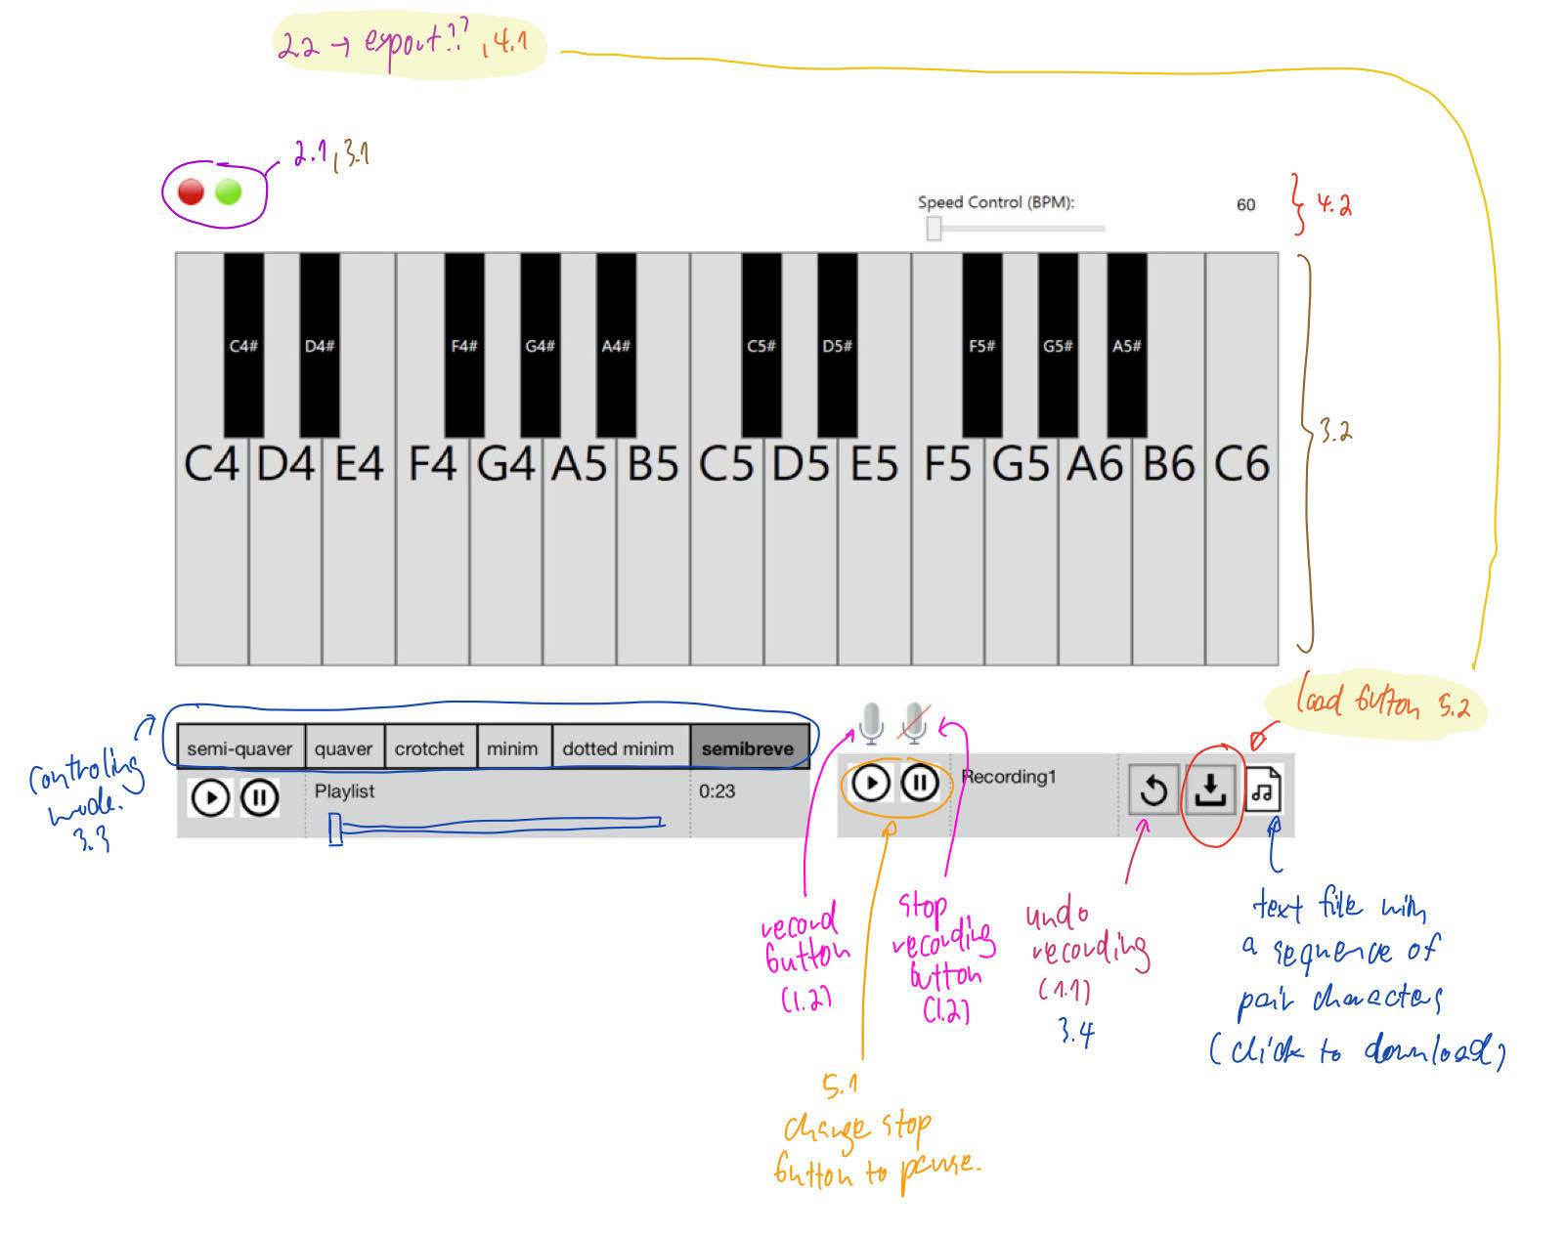
UI Draft Design
The User Interface has begun being developed so we can see how a user might use the application.
Storyboarded images of the UI are being produced to assist in discussion and development of the program.
Example drafted storyboard included on the right for how an interface may look.
The UI is being designed in consideration of the User Stories and how the usability of the UI will achieve the acceptance criteria.

Slide 8
Software Development Progress
Software platforms have been chosen: C#, .NET, XAML
Begun development, progress waiting for design phase to be completed.
UI foundations have begun being implemented to simplify the process later when more concrete elements are being inserted.
Common or vital functions in development since it is not necessary to write user stories for backend programming.

Slide 9
Hardware Design
High Level Hardware Diagrams
Simulated Development
Preliminary Synthesisation testing

Slide 10
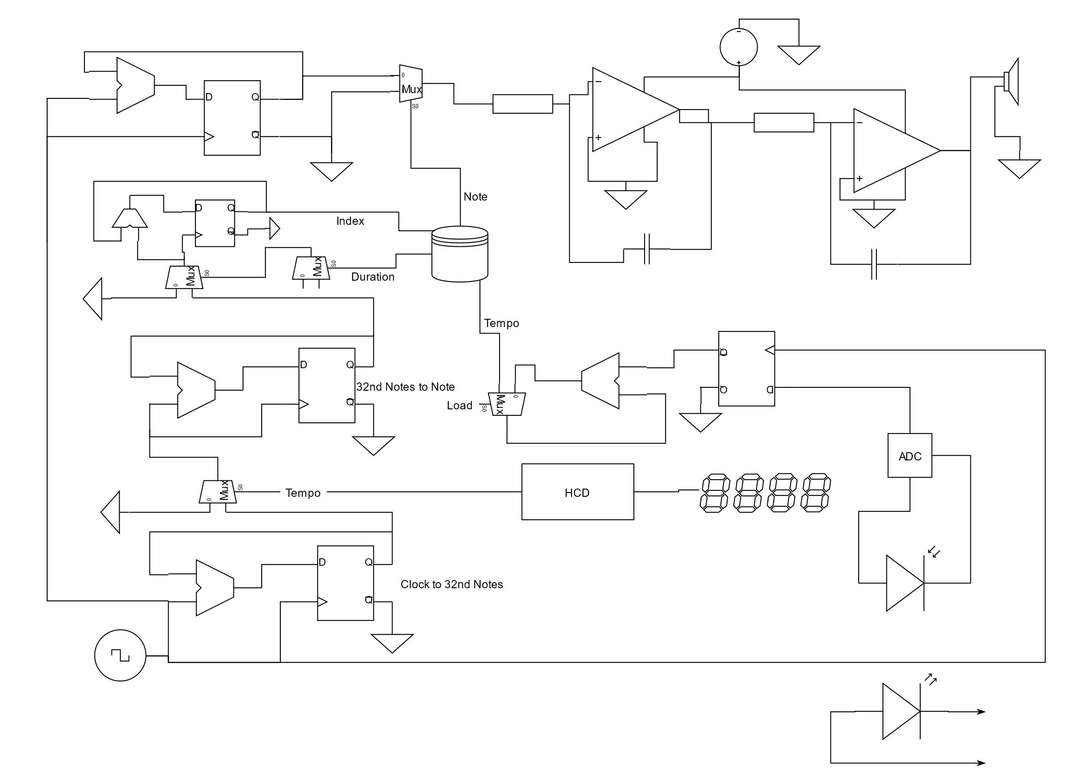
High Level Hardware Diagrams
Draft circuit diagram has been produced.
Some details omitted or abstracted due to unimportance or unimplemented status.
Converts clock signal with counters and comparison muxes to transform into clocks of musical note length.
IR LED/receiver is abstracted but will be used to control tempo changing.
Loudspeaker signal integrated with LM747 or equivalent Op Amp.
LUTs used for mapping input data to values.

Slide 11
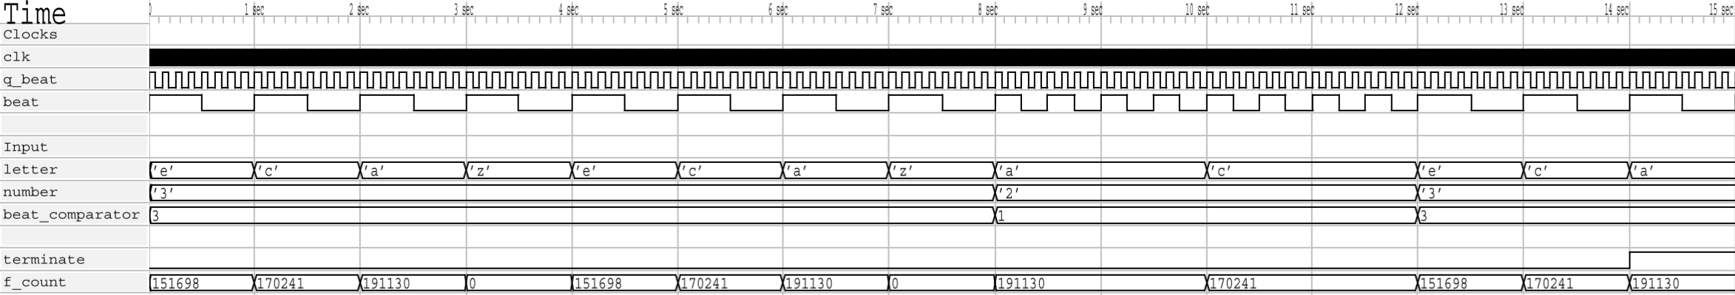
Simulated Development
Completed a working system with the memory stripped out and replaced with PC I/O.
Based on tempo signal calculates number of clock cycles in 32nd note.
Converts 32nd note into corresponding note duration clock.
Note duration clock feeds into counter for file offset.
Not tested: - Reading from memory, - changing tempo whilst running

Slide 12
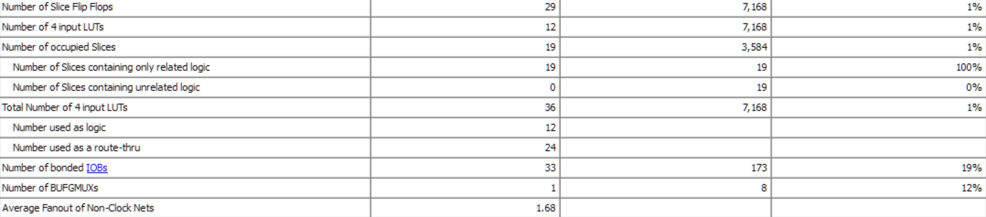
Preliminary Synthesisation Testing
Hardware design has been updated to include reading from memory for initial testing on FPGA boards.
Currently Xilinx successfully synthesises and generates bytecode for programming the hardware.
Implementation maps to only a small amount of the FPGA currently, room for larger designs if needed.

